Slide 1
DATA ANALYTIC
HOTEL BOOKING DATA
by Tushar nagpal

Slide 2
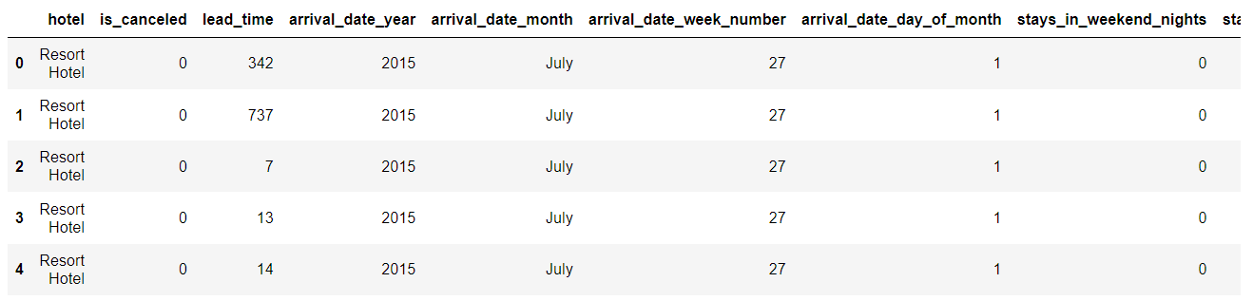
Checking First 5 records from this dataset
CODE : df.head()

Slide 3
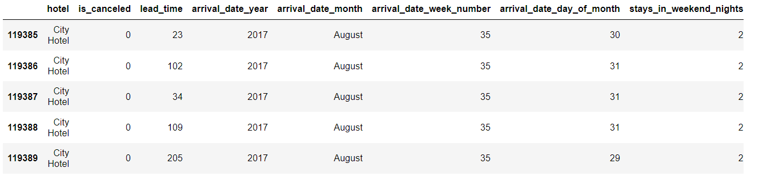
Checking Last 5 records from this dataset
CODE : df.tail()

Slide 4
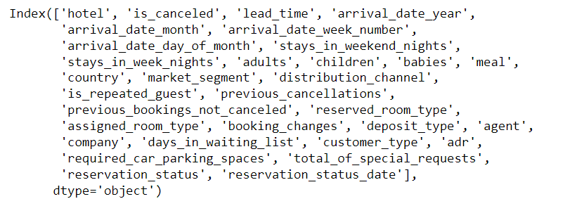
Checking columns of this dataset
CODE : df.columns

Slide 5
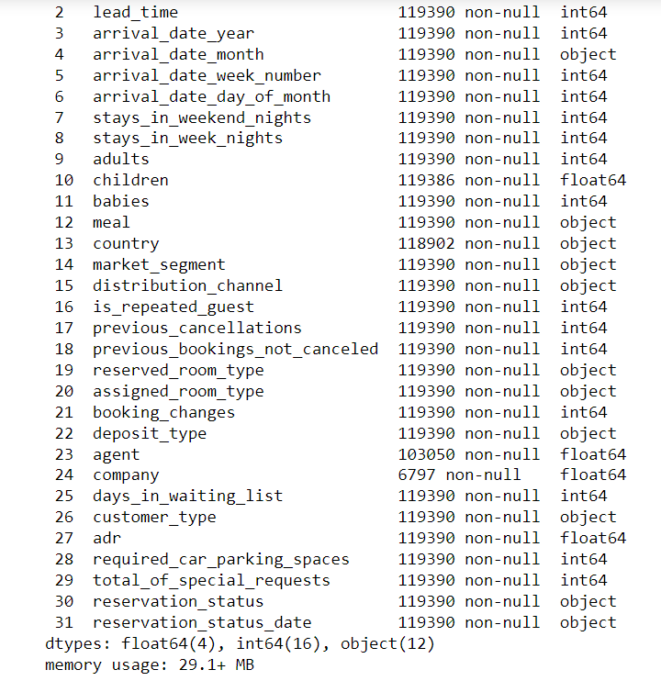
Showing Statistical information and Description about the data
CODE : DF.INFO()

Slide 6
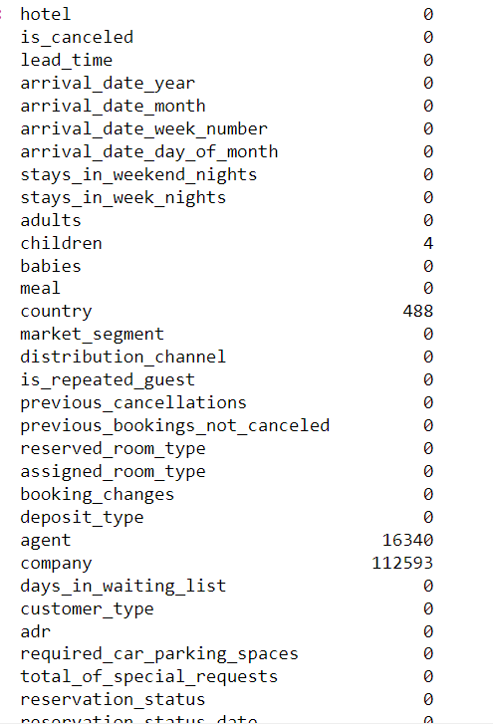
Checking null values present in each columns
CODE : df.isnull().sum()
COUNTRY COLUMN HAS 488 NULL VALUES
AGENT COLUMN HAS 16340 NULL VALUES
COMPANY COLUMN HAS 112593 NULL VALUES

Slide 7
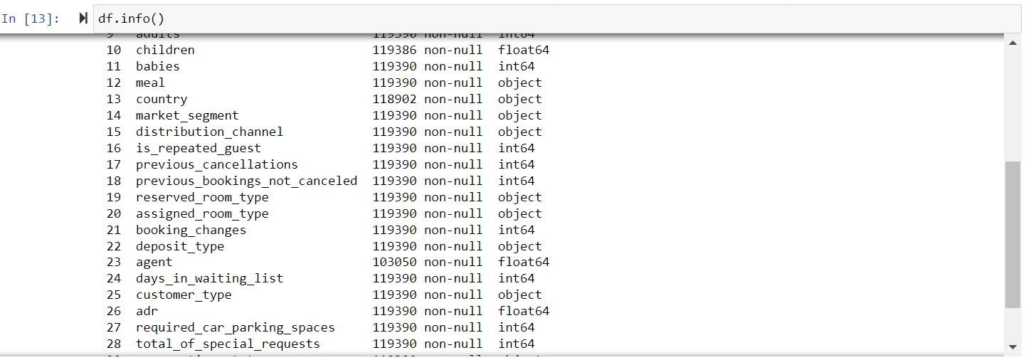
Drop 'company' column
CODE : df.drop("company",axis=1,inplace=True)

Slide 8
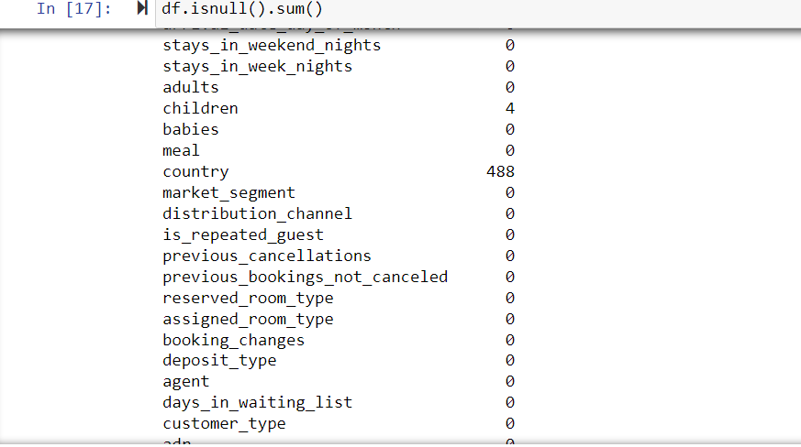
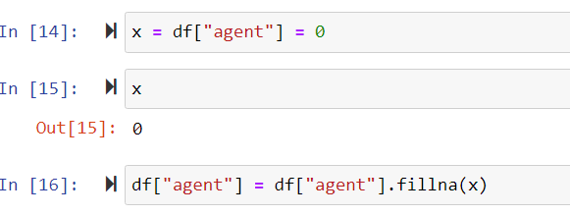
Replacing null values with zero in agent column

Slide 9
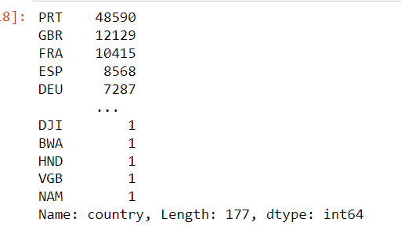
check count number in each country using
CODE : df["country"].value_counts()

Slide 10
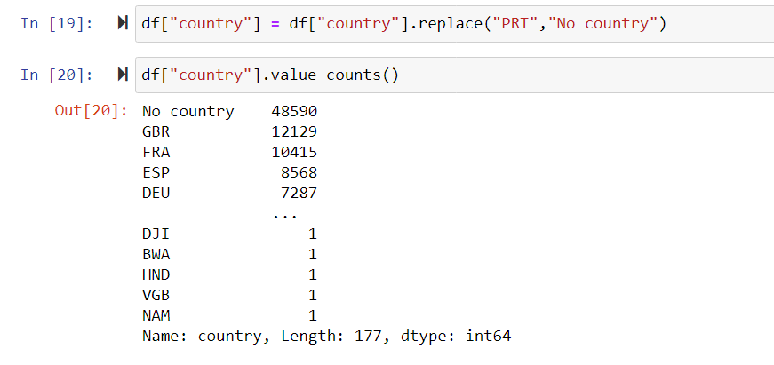
Replacing it with the most value count country with (‘No Countries’)

Slide 11
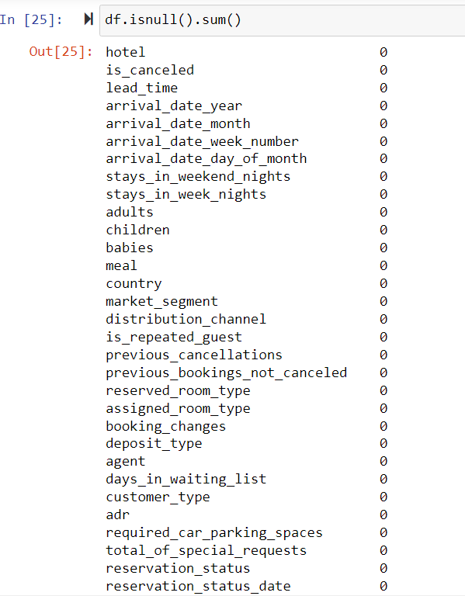
Checking null values after clearing them in each column

Slide 12
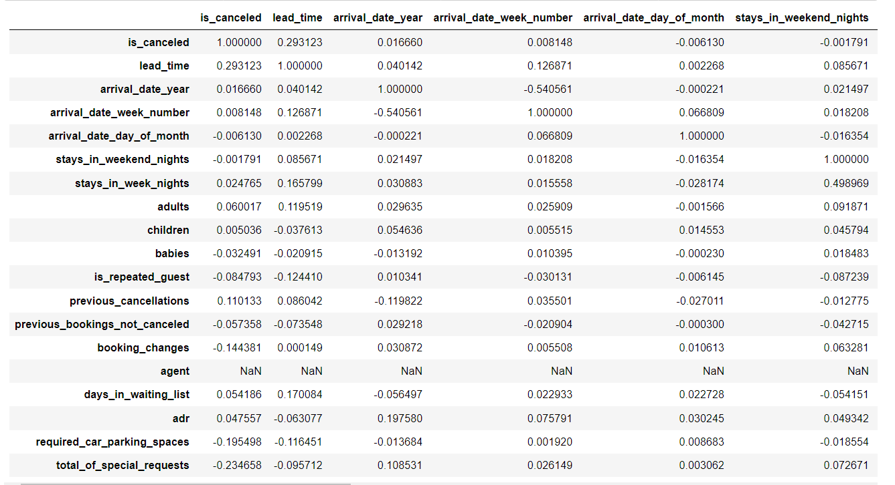
find correlation between each data
CODE : df.corr()

Slide 13
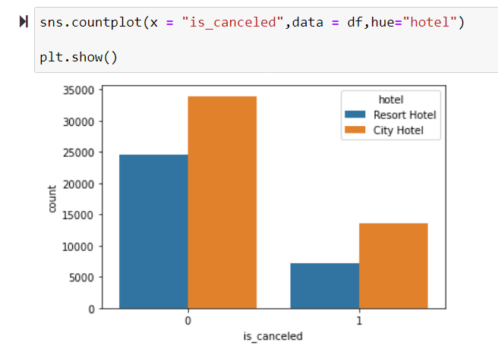
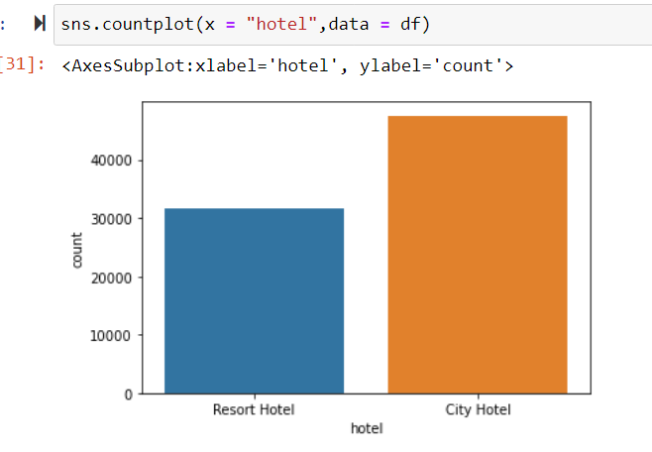
Create Count plot on single categorical variable 'hotel'
analyse which hotel gets cancelled the most by the customers (Using Seaborn Countplot)

Slide 14
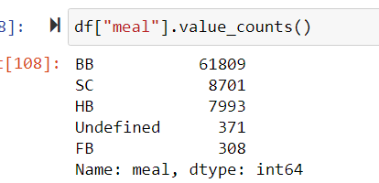
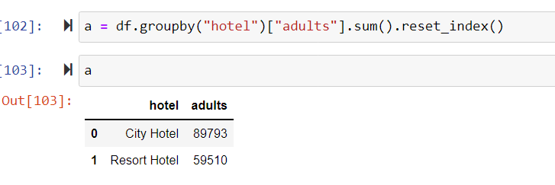
count the number of meal
count the number of adults in each hotel

